Slide 1
Sudoku Solver via Image Analysis
Cross-platform mobile application
By Szymon Stec

Slide 2
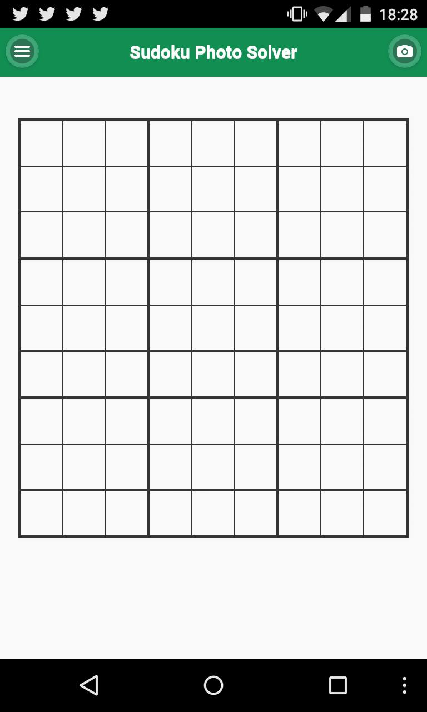
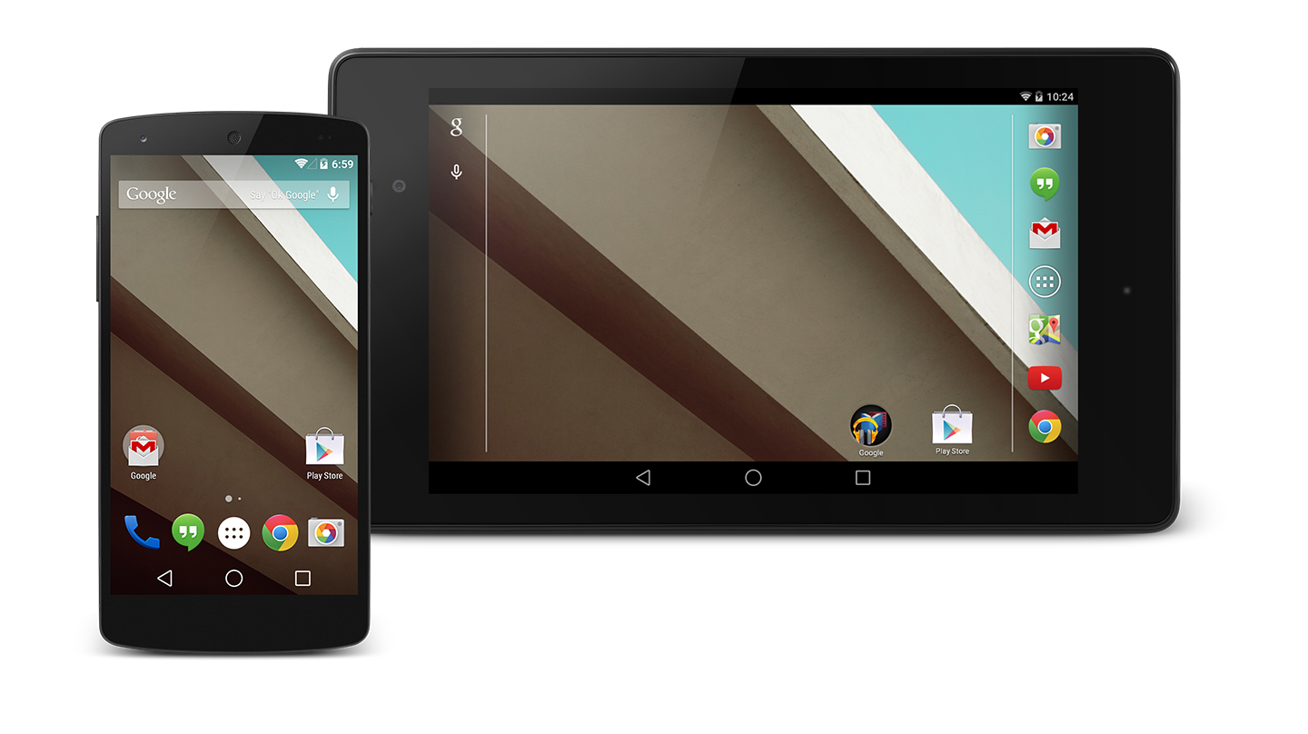
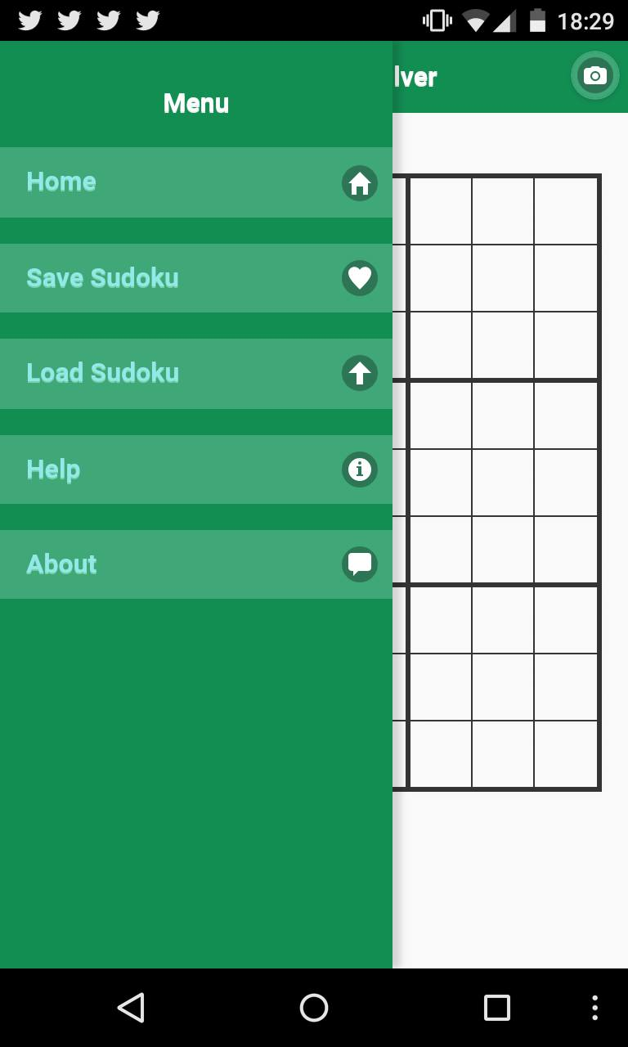



Project Description
Develop a cross-platform mobile application to solve Sudoku puzzles
Utilise image analysis to capture physical puzzles with the device’s camera and represent them on a mobile device
Implement Sudoku solver algorithm to automatically solve the puzzle
Implement clear and interactive User Interface suitable for all targeted platforms

Slide 3
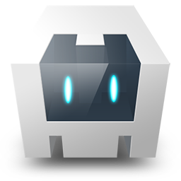
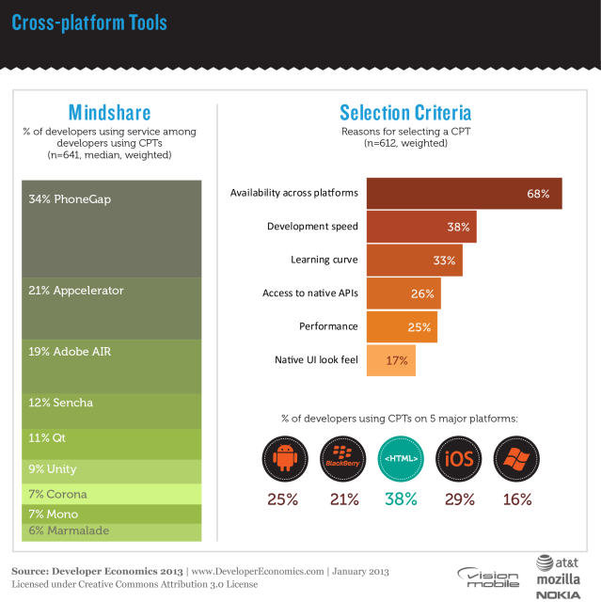
Technologies Used
Cordova/PhoneGap
JQuerry Mobile
HTML/ CSS/ JavaScript
Adobe PhoneGap Build
PhoneGap Developer App
Weinre Remote Debugging
PhoneGap Emulator

Slide 4
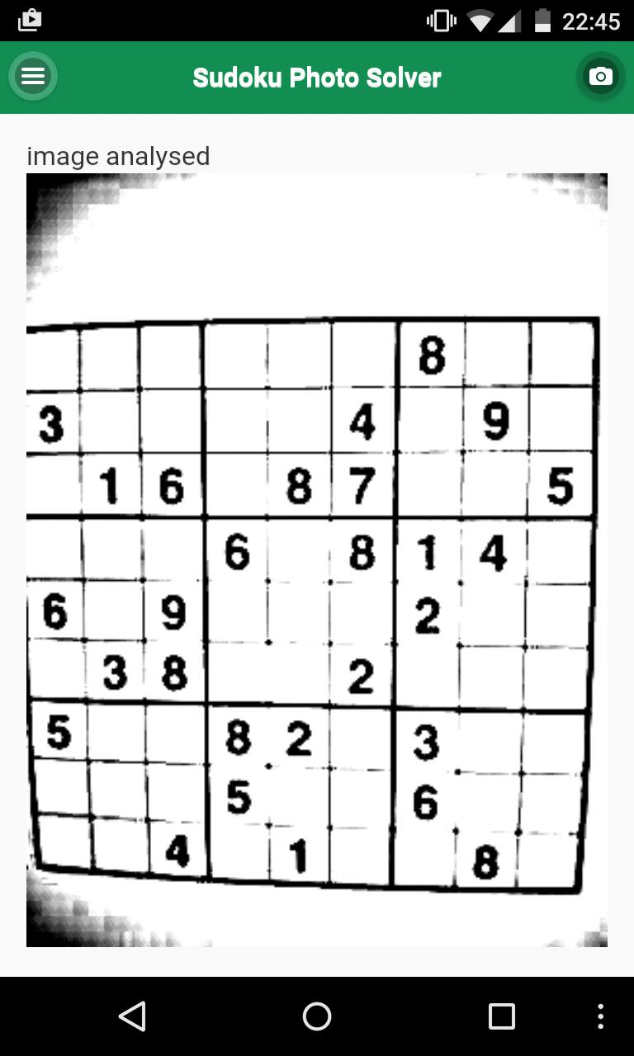
Image Analysis
Aim:
Capture the puzzle with inbuilt camera
Analyse captured image to retrieve puzzle information
Represent Sudoku information on the device
Approach:
Modify image to optimise the Character Recognition – glfx.js
Crop the picture for further optimisation – JCrop.js
Perform the Optical Character Recognition – OCRAD.js
Check the data against Sudoku rules
Enable User to correct mistakes

Slide 5
Image Analysis Issues
Limited recourses:
Only few Image Analysis libraries available
OCR libraries are not very reliable (might return inconsistent data)
Mobile platforms differences:
Cause incompatibilities with certain technologies
Limit available resources

Slide 6
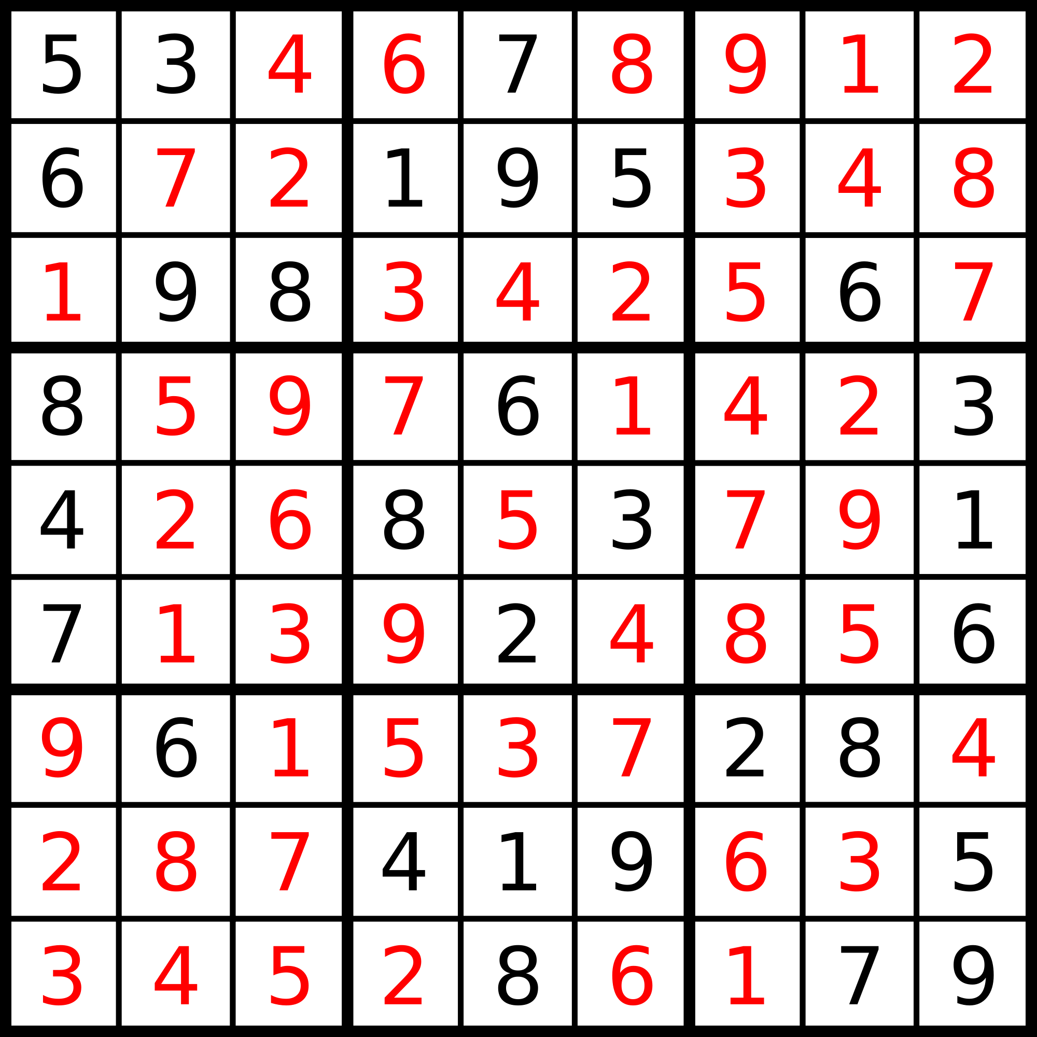
Sudoku Solver
Aim:
Solve the photographed Sudoku puzzle
Approach:
Various solving algorithms possibilities (Brute Force, Constraint Satisfaction Problems, Genetic Algorithm etc.), thus choice of the most appropriate one is important
Use solver algorithm to determine if the puzzle is solvable
Use solver to provide hints to the user

Slide 7
User Interface
Represent the puzzle and provide appropriate interaction solutions
Compromise application design to address platform differences
Provide the same level of functionality across the platforms and different devices
Single page design for more native-like experience

Slide 8
Project Demonstration

Slide 9
Technical Challenges
Improve OCR
Maintain cross-platform compatibility
Implement Handlebars templates for improved code quality and readability
Implementation of appropriate Sudoku solver algorithm with underlining data structure
Unit testing

